Slide 1

Networks of Workstations (distributed memory)
Lecture-4
Parallel & Distributed Computing

Slide 2
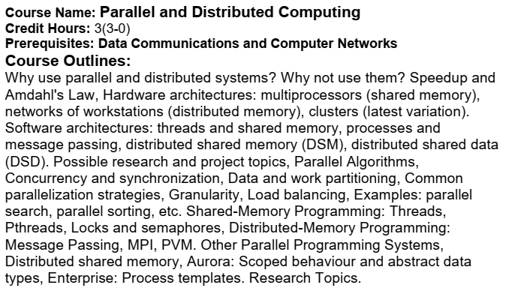
Course Outlines

Slide 3
Workstation
Workstation, a high-performance computer system as compared to mainstream personal computers, that is basically designed for a single user and has advanced graphics capabilities, large storage capacity, and a powerful central processing unit.
A workstation is more capable than a personal computer (PC) but is less advanced than a server (which can manage a large network of peripheral PCs or workstations and handle immense data-processing and reporting tasks).

Slide 4
Workstation cont…
Workstations were the first segment of the computer market to present advanced accessories and collaboration tools.
The increasing capabilities of mainstream PCs in the late 1990s have blurred the lines between PCs and technical/scientific workstations.

Slide 5
Network of Workstations (NOW)
High-speed networks and rapidly improving microprocessor performance make networks of workstations an increasingly appealing vehicle for parallel computing.
By relying solely on commodity hardware and software, networks of workstations offer parallel processing at a relatively low cost.

Slide 6
Network of Workstations (NOW) cont… commodity hardware and software
Commodity hardware (unlike purpose-built hardware), sometimes known as off-the-shelf hardware, is a computer device or IT component that is relatively inexpensive, widely available and basically interchangeable with other hardware of its type.

Slide 7
Network of Workstations (NOW) cont…
A network-of-workstations multiprocessor may be realized as a processor bank, a number of processors dedicated for the purpose of providing computing cycles.
Alternatively, it may consist of a dynamically varying set of machines on which idle cycles are used to perform long-running computations.

Slide 8
Network of Workstations (NOW) cont…
In the latter case, the (hardware) cost is essentially zero, since many organizations already have extensive workstation networks in place.
In terms of performance, improvements in processor speed and network bandwidth and latency allow networked workstations to deliver performance approaching or exceeding supercomputer performance for an increasing class of applications.

Slide 9
Network of Workstations (NOW) cont… Distributed Memory
Distributed memory refers to a multiprocessor computer system in which each processor has its own private memory.
Computational tasks can only operate on local data, and if remote data are required, the computational task must communicate with one or more remote processors.

Slide 10
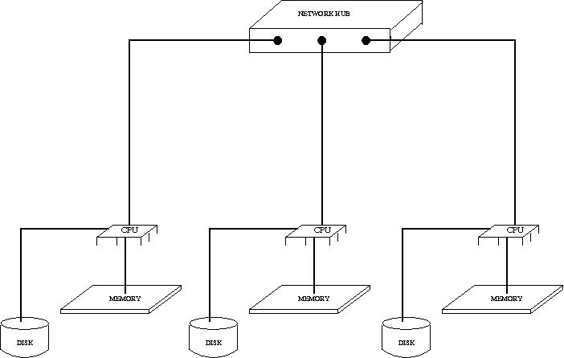
Network of Workstations (NOW) cont… Distributed Memory

Slide 11
Network of Workstations (NOW) cont… Distributed Memory
In a distributed memory system there is typically a processor, a memory, and some form of interconnection that allows programs on each processor to interact with each other.

Slide 12
Network of Workstations (NOW) cont… Distributed Memory (programming issues)
The key issue in programming distributed memory systems is how to distribute the data over the memories.
Depending on the problem solved, the data can be distributed statically, or it can be moved through the nodes.
Data can be moved on demand, or data can be pushed to the new nodes in advance.

Slide 13
Network of Workstations (NOW) cont… Distributed Memory (programming issues)
Data can be kept statically in nodes if most computations happen locally, and only changes on edges have to be reported to other nodes.
An example of this is simulation where data is modeled using a grid (non-interactive workloads), and each node simulates a small part of the larger grid.

Slide 14
Network of Workstations (NOW) cont… Distributed Memory (programming issues)
On every iteration, nodes inform all neighboring nodes of the new edge data.

Slide 15
Shared vs. Distributed Memory cont…
There are two kinds of multiple-processor systems exist:
Multi-Processors (Shared/ Distributed)
Multi-Computers (Distributed)

Slide 16
Shared vs. Distributed Memory cont…
In a multi-processor two or more CPUs share a common main memory.
Any process on any processor, can read or write any word in shared memory, simply by moving data to or from the desired location.
In a multi-computer, in contrast, each CPU has its own private memory. Nothing is shared.

Slide 17
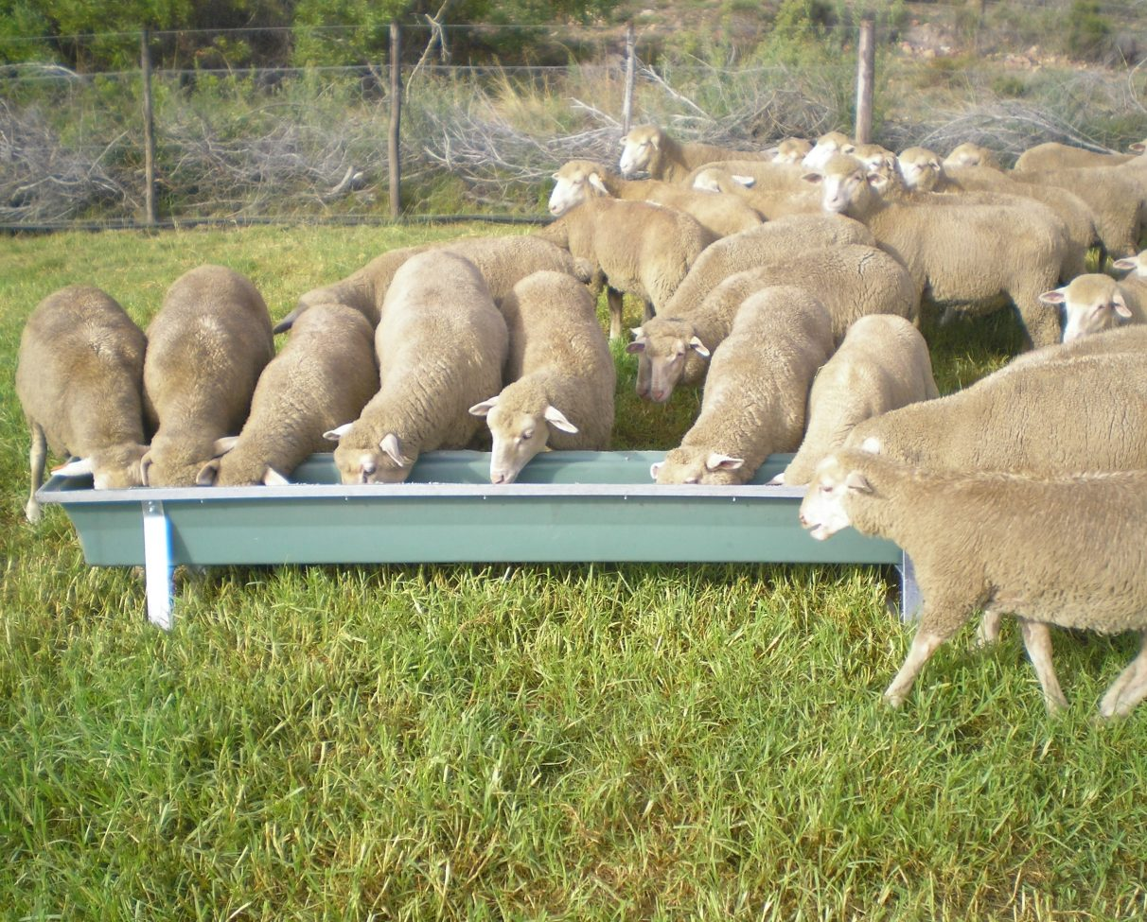
Shared vs. Distributed Memory cont…
To make an agriculture analogy, a multiprocessor is a system with a herd of sheep (processes) eating from a single feeding through (shared memory).

Slide 18
Shared vs. Distributed Memory cont…
A multicomputer, on the other hand, is a design in which each sheep has its own private feeding through (distributed memory).

Slide 19
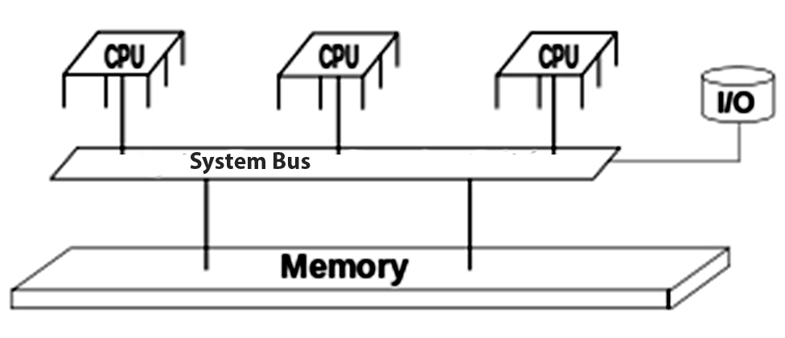
Shared vs. Distributed Memory cont…

